Slide 1


ArtFL: Exploiting Data Resolution in Federated Learning for Dynamic Runtime Inference via Multi-Scale Training
IPSN 2024
Siyang Jiang, Xian Shuai, Guoliang Xing
Department of Information Engineering The Chinese University of Hong Kong
Notes:
Hello，everyone I am Siyang Jiang.
Today I like to present my paper named ArtFL: exploring date Exploiting Data Resolution in Federated Learning for Dynamic Runtime Inference via Multi-Scale Training.
This work is collaborated with Dr. Xian Shuai and my advisor Prof. Guoliang Xing.

Slide 2
Outline
Background
Motivation and Methodology
Experiments and Evaluation
Discussion and Conclusion
Notes:
This is today's outline we may have four parts here.
The first part is the background and then I would like to introduce the motivation and methodology.
In the following I would like to introduce the experiments and the evaluations.The last part is the discussion and the conclusion.

Slide 3
Outline
Background
Motivation and Methodology
Experiments and Evaluation
Discussion and Conclusion
Notes:
This is today's outline we may have four parts here.
The first part is the background and then I would like to introduce the motivation and methodology.
In the following I would like to introduce the experiments and the evaluations.The last part is the discussion and the conclusion.

Slide 4
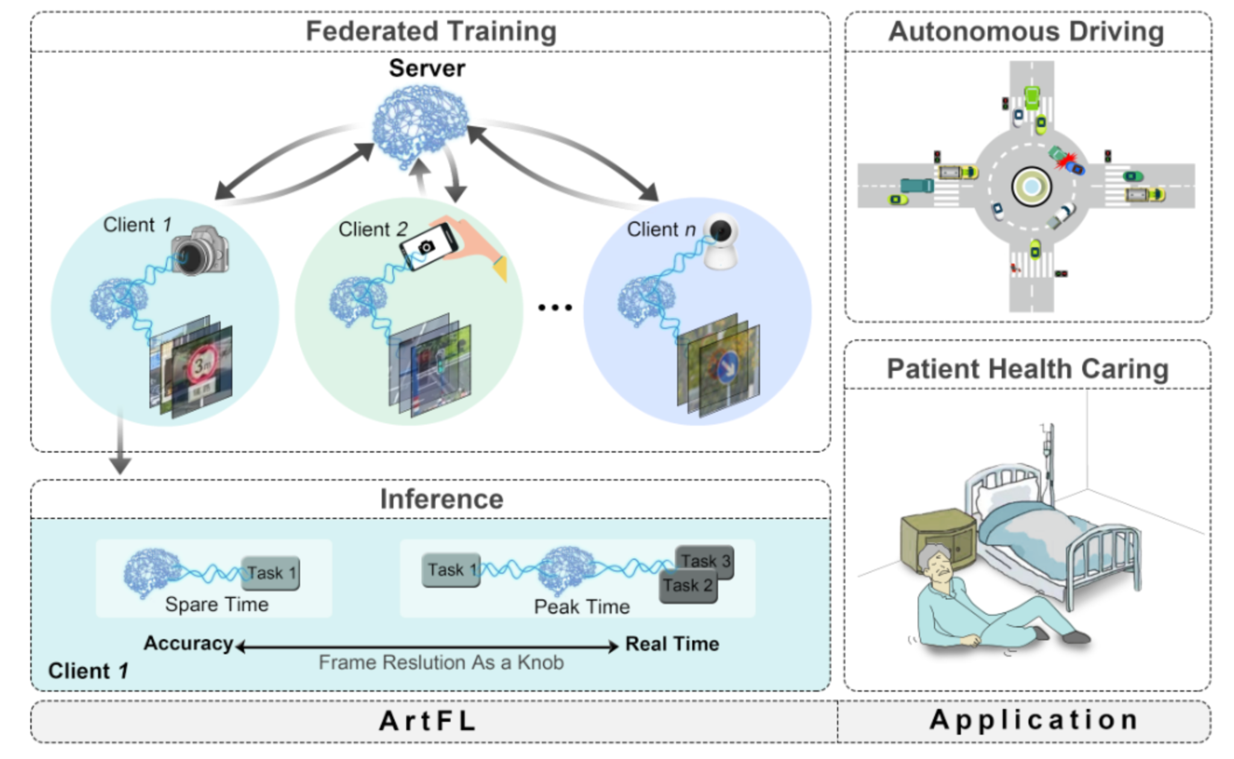



Background– Major Challenges
Federated Learning (FL) in Mission-critical Systems on Edge Devices
Home Caring
Smart Phones
Federated Learning
Real-time Performance
Accuracy Performance
Auto-Driving
Edge Devices
Trade-off?
Notes:
[Click] This work mainly focus on the fe learning in mission critical system on edge devices. In the beginning I would like to introduce the basic concept of federal learning. The federal learning can be regarded as a kind of distributed learning. The goal of fe learning is to train a global model on the server and the data is located in the Edge devices.
Due to the privacy concern the client only train its own model and transfer the knowledge to the server; and the server aggregate the knowledge from different kinds of clients and then transmitted aggregated model to the clients. It will be repeated several rounds until the model is converged.
[Click] However, in some Mission-critical Systems such as home-based caring or auto-driving, tasks running on edge systems usually impose dynamic real-time requirements. Meeting this dynamic deadline becomes even more challenging due to computational resource contention from other tasks on edge devices. For example, the traffic sign recognition task on a smart vehicle may not immediately access the GPU recourse for inference due to other preemptive high-priority tasks such as passing vehicle detection.
[Click] So, in that cases, Therefore, in traffic sign recognition tasks, it is acceptable to trade-off some accuracy performance for real-time performance.

Slide 5
Background
Major challenges in mission-critical FL systems
A trade-off between real-time and accuracy performance in dynamic time puts constraints on heterogeneous edge devices.
Long training duration in waiting time due to the heterogeneity of edge devices.
Notes:
There are mainly two major challenges in mission-critical FL systems:
The first one is Trade-off the real-time performance and accuracy performance in dynamic time constraints on heterogeneous edge devices and the second one is belongs to training phase in FL systems, i.e., Long training duration in waiting time due to the heterogeneity of edge devices.
【引入的很生硬】

Slide 6
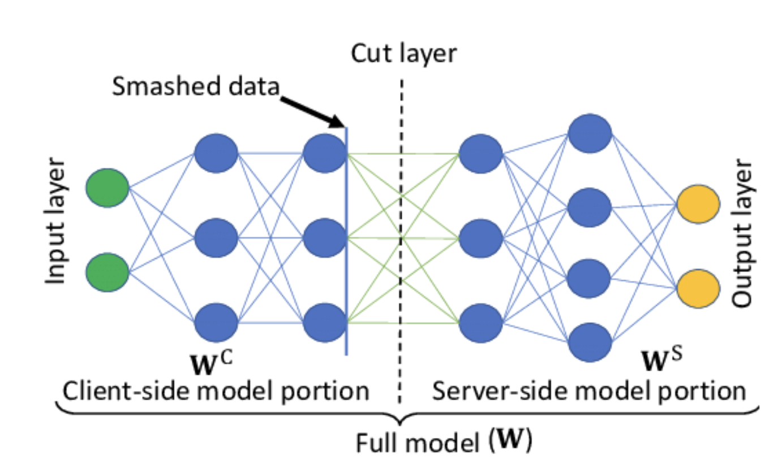
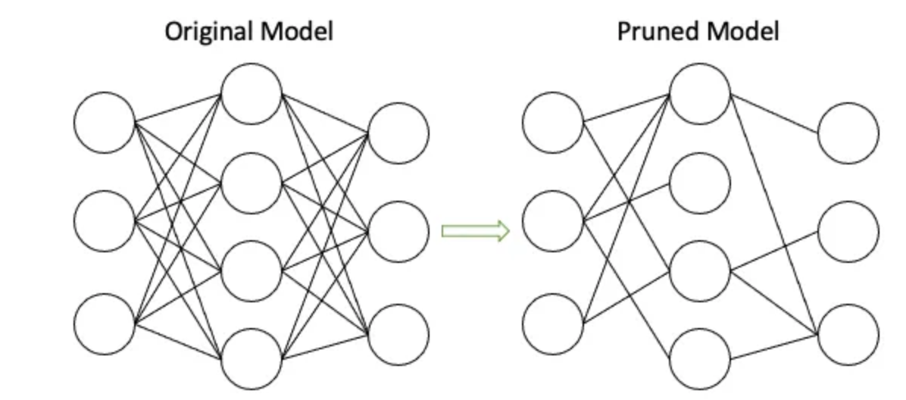
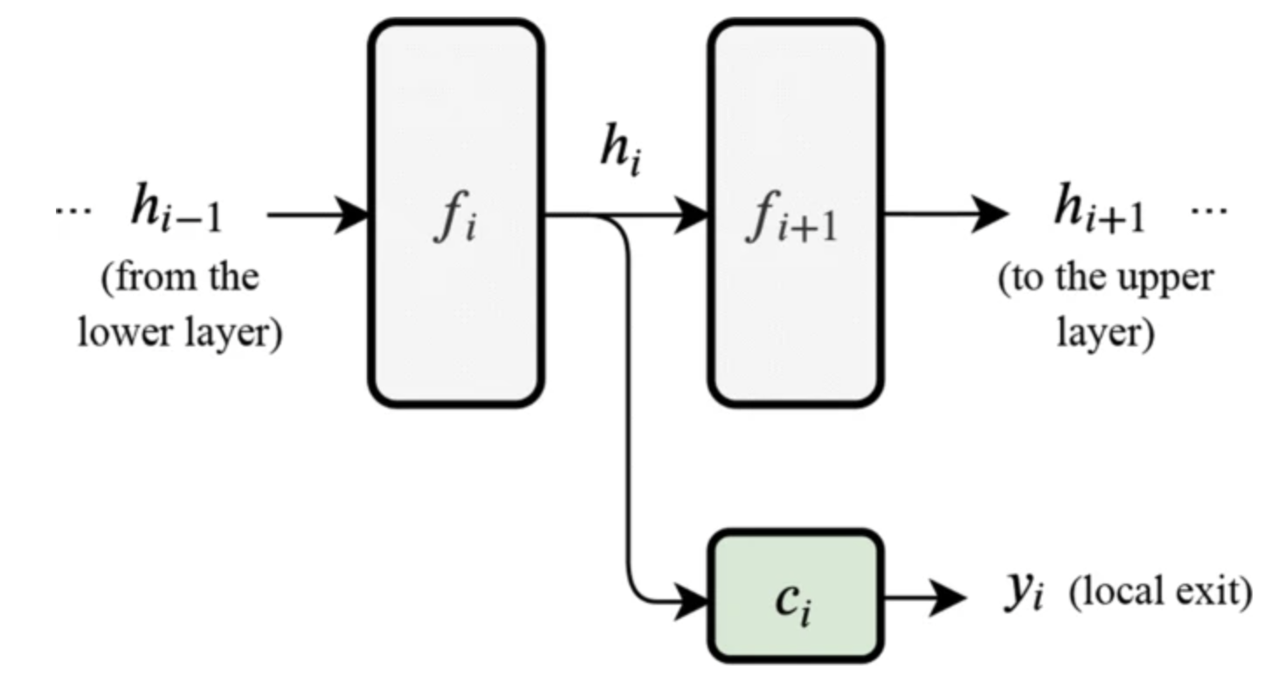
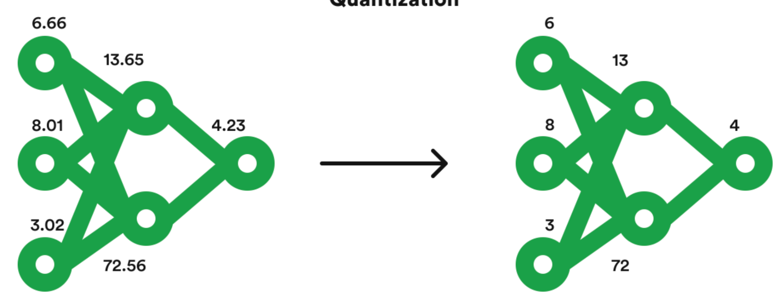
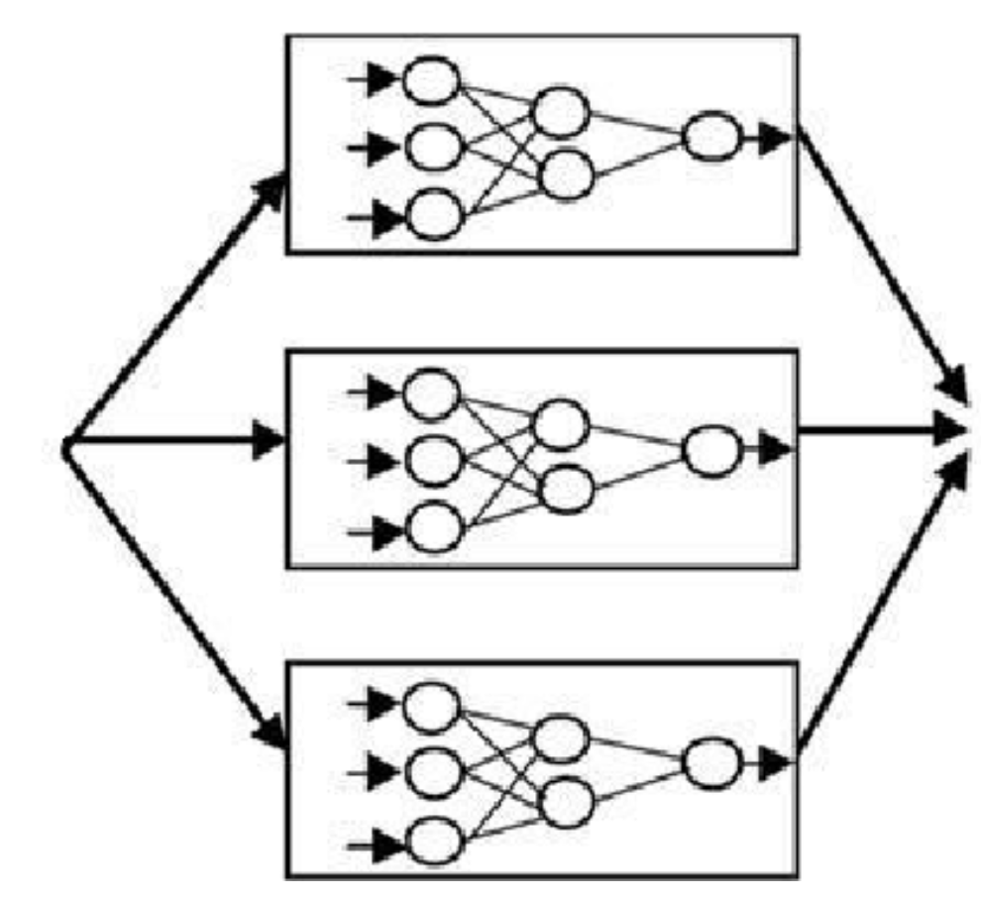
Background
How to effectively inference?
Model Compression
Dynamic Inference
Splitting Learning
Pruning
[SplitGP, IEEE INFOCOM 2023]
Computation and Storage overhead on edge
Lack of the dynamics
[PruneFL, IEEE TNNLS 2021]
Early Exiting
[Branchynet, ICRP 2016]
Quantization
Multi-Models
[QuantFL, JMLR 2023]
[Chameleon, SIGDC 2018]
Notes:
To effectively inference, there are mainly two types approach.
The first one is model compression, including pruning and quantization. In particular, the pruning methods aims to
The quantization is the

Slide 7
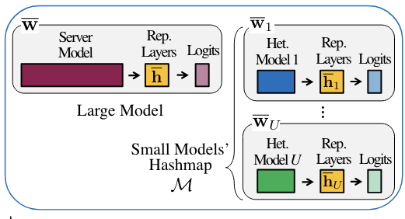
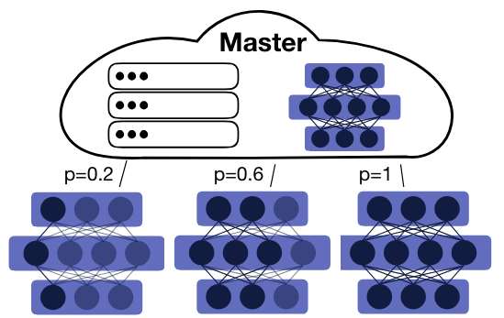
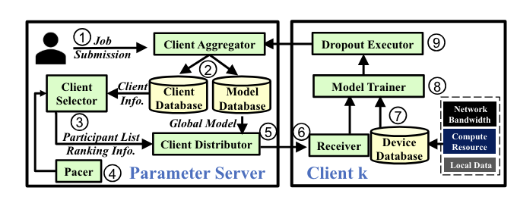
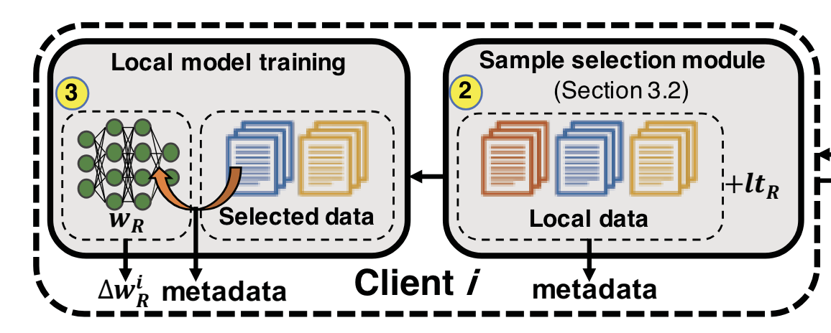
Background
How to solve the system heterogeneity issue in FL?
Knowledge Distillation
Partial Training
Distillate a small model from the big model
Reduce the computation by training subnets
[Fed-ET IJCAI 22’]
[FjORD NeurIPS 21’]
Do NOT consider with the dynamic time constraint in inference time
Sample Selection
Client Selection
Select Important clients from clients for training
Select Important samples from clients for training
[PyramidFL Mobicom 22’]
[FedBalancer Mobisys 22’]

Slide 8
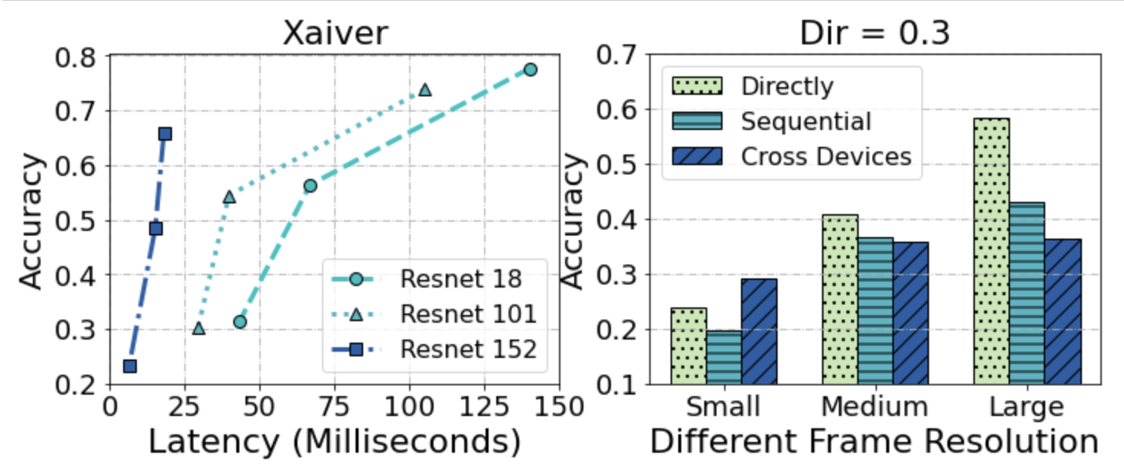
Motivation
Trade off between latency and accuracy
Large models have high latency while high accuracy, vice versa.
Multi-scale training is one of the answers.
If I am greedy,
Dynamically prefer latency or accuracy based on the application requirements on the edge.

Slide 9
Motivation
Training and inference resolution discrepancy in multi-scale training in FL
Multi-scale training denotes that we use different scale input in training stage
Directly adopt naive multi-scale training in FL is not trivial

Slide 10
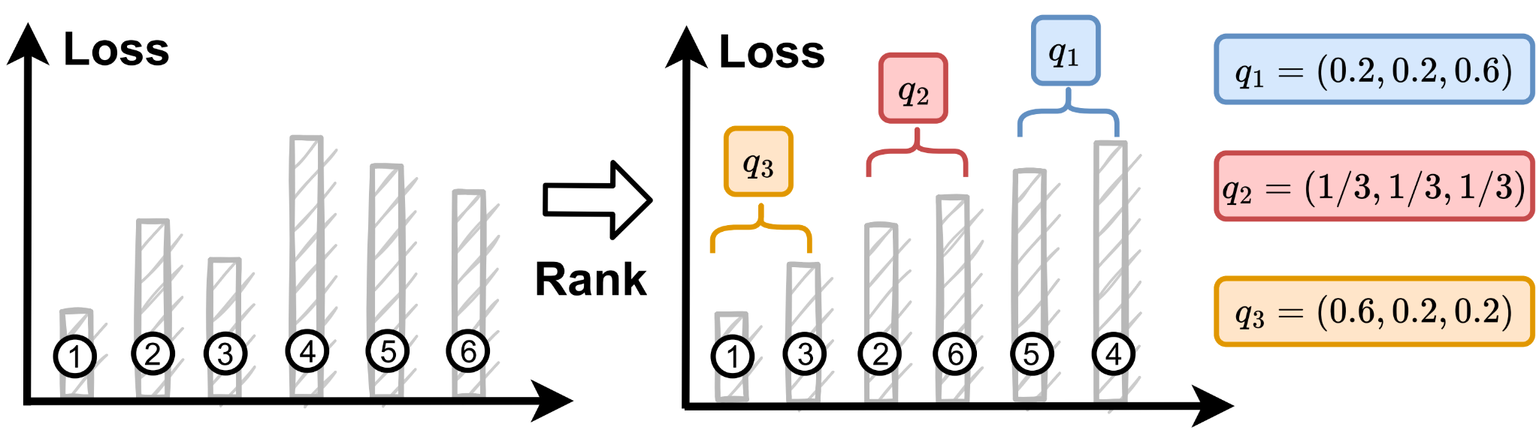

Methodology
Data-Utility-Based Multi-Scale Training
Design a probability pool in advance
For each client,
Select the probability vector from the pool based on loss ranking
Larger loss clients to be paid more attention in future training.

Slide 11
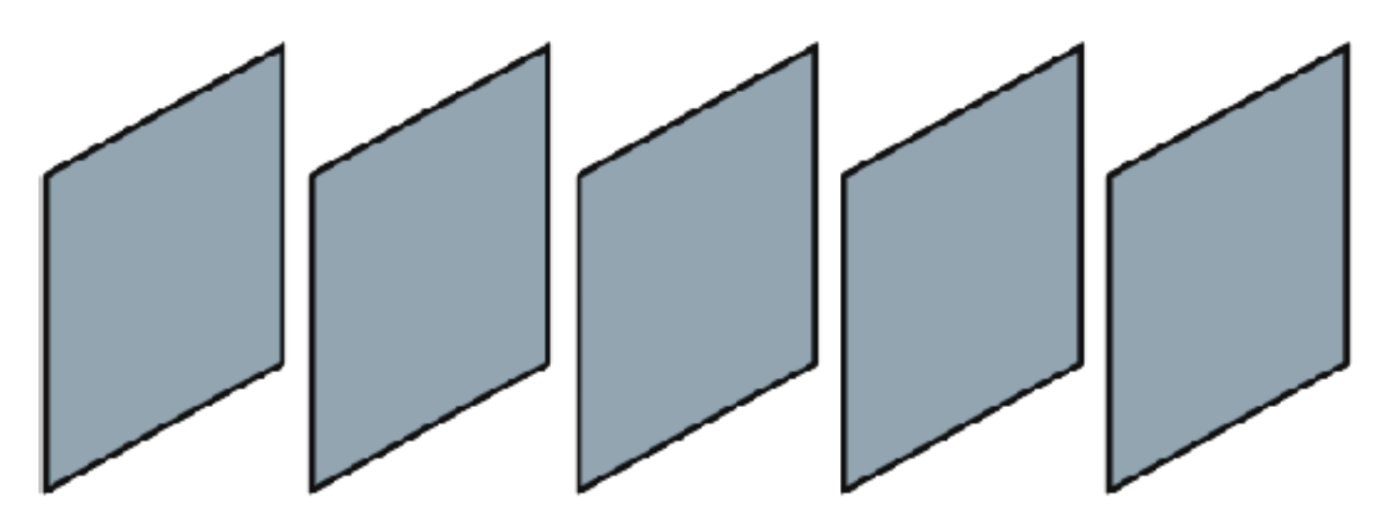
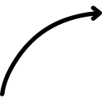
Methodology
Optimal Frame Resolution Selection
Select the resolution for two adjacent frames based on the SSIM ( structural similarity index measure)
Only the SSIM is less than a threshold, it will be assign the largest resolution.
SSIM
SSIM
SSIM

Slide 12

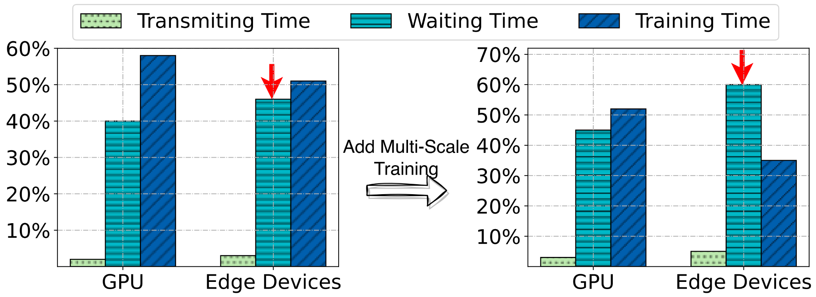
Methodology
Latency-Based Dynamic Data Dropping
Waiting Duration is pre-longer after adding multi-scale training
Adding Multi-Scale Training

Slide 13
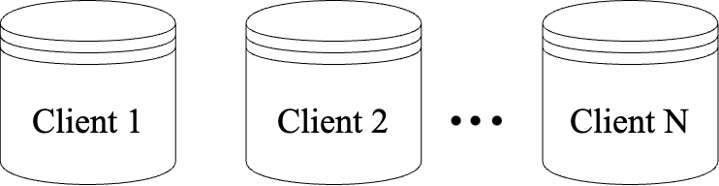
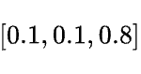
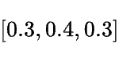
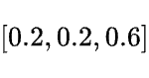
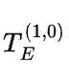
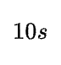
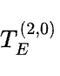
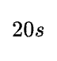
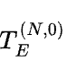
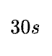
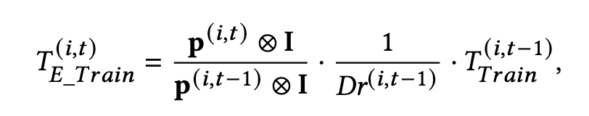
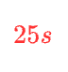
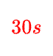
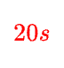
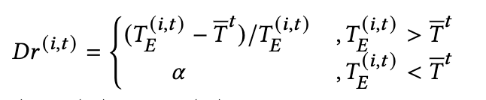
Methodology
Latency-Based Dynamic Data Dropping
Dropping some data due to information redundancy
Estimate next round training time according to the previous training time and the probability vector
Discard a percentage data according to a dropping function

Slide 14
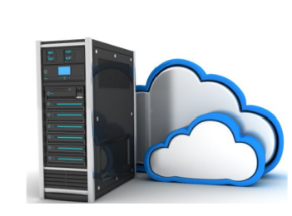
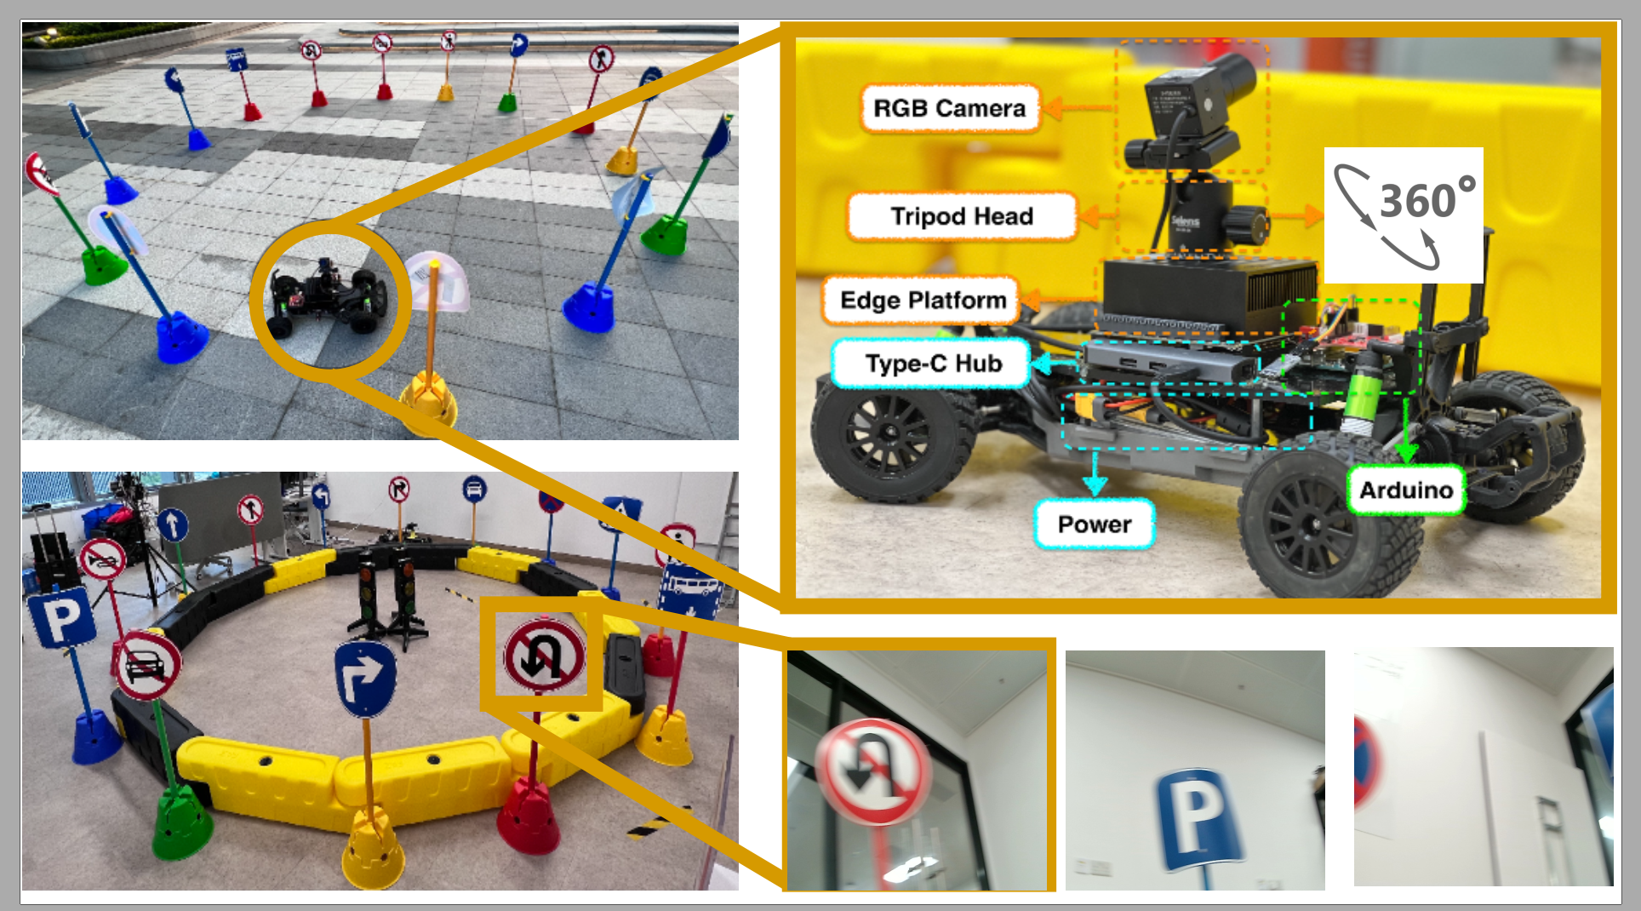
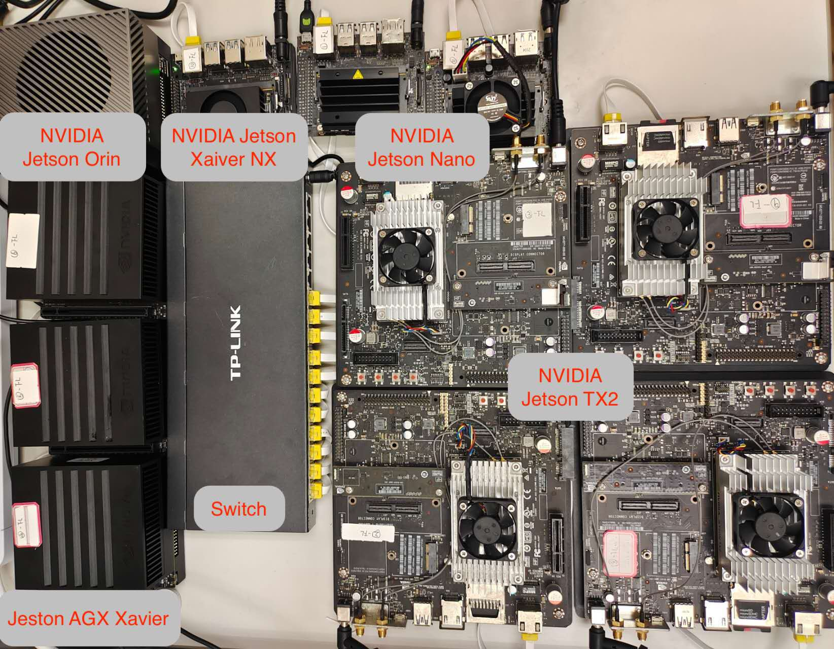
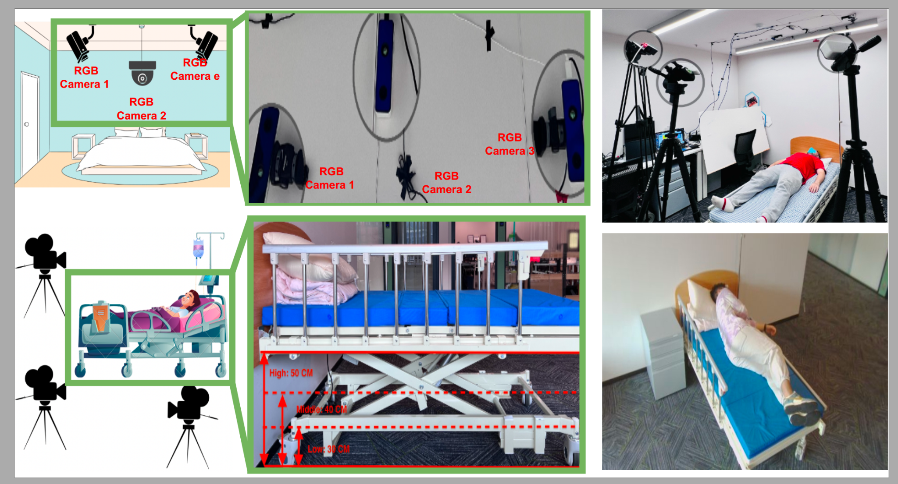
Experiment Platforms and Testbeds
Cloud Server
A100 * 4
Edge Platform
Jetson Orin * 1
Jetson Xavier *3
Jetson Xavier NX *18
Jetson TX2 * 6
Jetson Nano *2
Cloud Server
Smart Vehicle TestBed
Hardware Platform
Smart Health TestBed

Slide 15
Experiment Testbed
5 Evaluation Datasets
Dataset | Tasks | Clients
Smart Health | Human Action Recognition | 21
Smart Vehicle | Traffic Sign Recognition | 24
CIFAR-10 | Image Classification | 10
CIFAR-100 | Image Classification | 50
Tiny-ImageNet | Image Classification | 50
6 Evaluation Baselines
Efficient Inference (EI) Baselines: FlexDNN [SEC 20’], RANet [NeurlPS 20’]
FL Baselines: FedAvg [AISTATS 17’], FedProx [MLSys 20’], FedDyn [ICLR 21’], BalanceFL [IPSN 22’]

Slide 16
Evaluation Result
Major Result in Accuracy - Dynamic Inference in EI and FL Baselines
Baseline | Methods | Smart Vehicle | Smart Health
EI Baselines | RANet | 0.43 | 0.44
 | FlexDNN | 0.39 | 0.35
ArtFL |  | 0.93 (+53%) | 0.81 (+45%)
FL Baselines | Fedavg | 0.87 | 0.80
 | FedProx | 0.83 | 0.82
 | FedDyn | 0.88 | 0.83
 | BalanceFL | 0.85 | 0.75
ArtFL |  | 0.94 (+7%) | 0.86 (+12%)

Slide 17
Evaluation Result
Major Result - Reduce training waiting time (Second)
Baseline | Methods | Smart Vehicle | Smart Health
FL Baselines | Fedavg | 134.52 | 351.23
 | FedProx | 139.21 | 376.41
 | FedDyn | 141.23 | 371.91
 | BalanceFL | 197.83 | 534.24
ArtFL |  | 101.21 (-48.8%) | 227.35 (-57.4%)

Slide 18
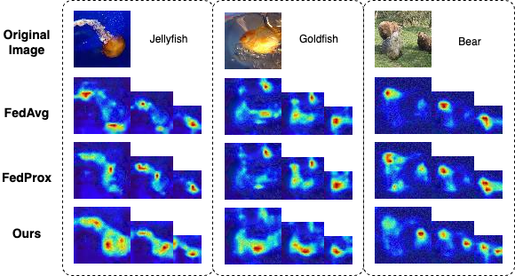
Discussion
Why ArtFL works well?
What the model learns from multi-scale inputs?
Structural Information.
Class-Active Mapping
Notes:
so we would like to discuss why I f l works well.
In fact, we transfer this problem to what the model learns from the multi-scale input. We find that it's the skill invariant information.
[Click ] So to prove our opinion we conducted an experiment involving class activation mapping. This demonstrates the specific areas that the the models focus on. For example, if a human being want to recognize a jellyfish. We use the shape of jellyfish and then to know that okay this is a jellyfish not the goldfish of any beer. So we can see that in FedAvg and FedProx. the model can't recognize the shape of the jellyfish while ArtFL can recognize the structural information.
Such information is invariant information in various scales.

Slide 19
Conclusion and Future work
We propose a novel FL system designed to support dynamic inference requirements.
Extensive experiments show that ArtFL delivers significant improvement over state-of-the-art baselines across public datasets and two real-world testbeds.
In the future, we will extend ArtFL to other data modalities and more complex tasks.

Slide 20



ArtFL: Exploiting Data Resolution in Federated Learning for Dynamic Runtime Inference via Multi-Scale Training
Thanks!
Siyang Jiang, Xian Shuai, Guoliang Xing
Visit AIoT Lab
Notes:
That’s all. Thanks for your time. I am looking forward to your comments and suggestions.

